Slide 1
BurstSketch: Finding Bursts in Data Streams
Zheng Zhong, Shen Yan, Zikun Li, Decheng Tan, Tong Yang, Bin Cui
Notes:
Hi everyone. My name is ZHENG ZHONG. I am a undergraduate student at the Peking University. In the next 20 minute, I am going to introduce a new data structure which can find burst item in high-speed data streams in real-time. And we called the data structure “BurstSketch”.

Slide 2
01
Part One
Background
Notes:
Part one is about the background.

Slide 3
Background
Data stream model：
$$e_{1}$$
$$e_{2}$$
$$e_{1}$$
$$e_{3}$$
$$e_{4}$$
$$e_{4}$$
$$e_{2}$$
$$e_{1}$$
$$e_{3}$$
time
Notes:
The data stream model is that items will appear in a time sequence one by one. Therefore, one challenge about the high-speed data stream process is that we must process it very fast. Otherwise, we may lose the items.

Slide 4
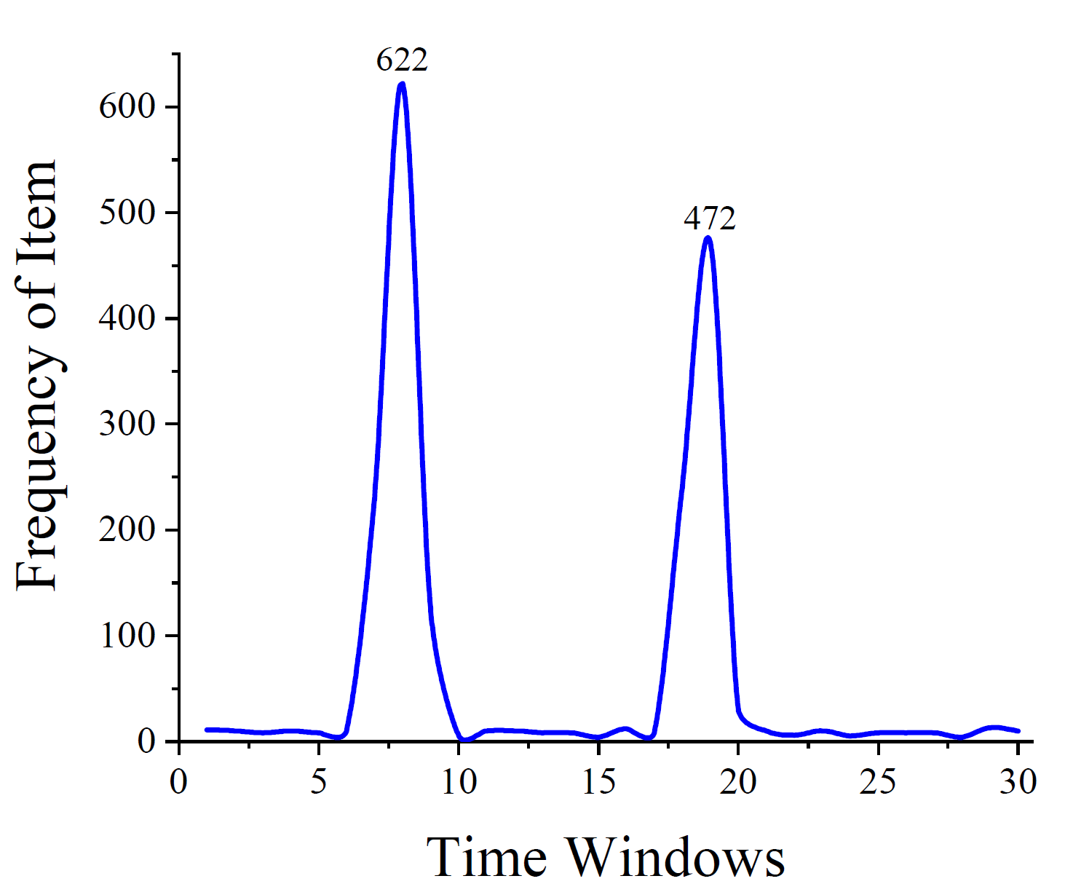
Background
Burst is a common pattern in data streams, which is characterized by a sudden increase in terms of arrival rate followed by a sudden decrease.
4 window burst
Sudden increase
$$(k times)$$
Sudden decrease $(\frac{1}{k} times)$
Burst threshold
1
2
3
4
5
6
time
Notes:
Our target, burst, is a common pattern in data streams, which is characterized by a sudden increase in terms of arrival rate followed by a sudden decrease. Let’s see an example. These two patterns are bursts. We can see the speed of this item first increase sharply and then decrease sharply. Let see another example. This is the timeline. At first, we divide the timeline into many time windows. In the first window, the item appears several times. In the second window, the item appears much more times than the first window. Specifically, when the number of appearances in the current window is k times larger than the previous window, we regard that a sudden increase occurs. In this case, the second window is the sudden increase window. The third window’s frequency seems similar to the second window. And also the fourth and fifth windows. In the sixth window, the item appears much less than the fifth window. Specifically, when the number of appearances in the current window is one over k times smaller than the previous window, we regard that a sudden decrease occurs. In this case, the sixth window is the sudden decrease window. And we regard the number of the burst last as burst’s width, which is 4 in this case. We also define that burst’s frequency of the windows between the sudden increase window and the sudden decrease window must be higher than a burst threshold. Because first we usually do not care about infrequent item’s burst in practice. Second, if an item’s frequency in the recent 3 windows is 0, 1, 0, it also has sudden increase and sudden decrease, but regard this kind of pattern as a burst is obviously unreasonable.

Slide 5
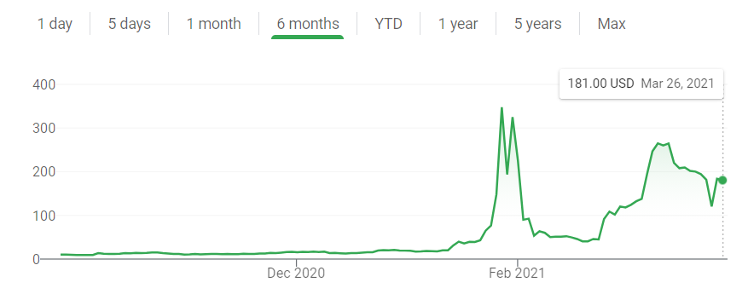
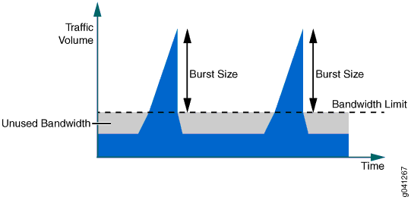
Background
When a burst occurs…
Financial market manipulation may occur
Should temporarily assign more bandwidth
A abnormal or noticable event may occur
Notes:
Burst has a lot of applications in multiple areas. In the financial area, if a burst of a shock’s price occurs, it may mean a market manipulation happens. This example is about the GME event. If you paid attention to the American stock market, you must know it. It was indeed about market manipulation. In the network area, bandwidth is a valuable resource. You can see this line is the bandwidth level, which normally can cover the traffic volume. However, when a burst occurs, the traffic volume will higher than the bandwidth limit, and some network packets will be discarded, which will cause severe problems. So we should find these burst in time, and temporally assign more bandwidth for it. In the data mining area, when the searching times of a word burst, it may mean some noticeable event occur. We can see that the searching times of Biden burst in November 1 to November 7. And we all know that in these days people were holding the American election.

Slide 6
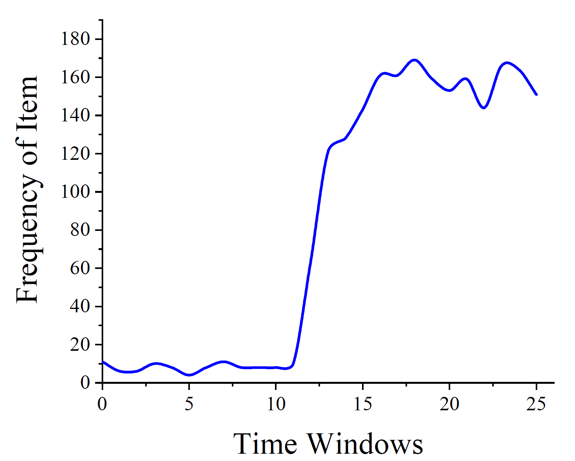
Background
Other definition：Acceleration
Large acceleration
Notes:
In fact, because of the importance of burst, burst has many definitions. Except ours, the most influential definition is large acceleration. Let’s see an example. In this point, the acceleration of the item is large, so they regard it as a burst. However, for the above applications, this definition is not complete, because an item’s speed can just increase sharply and become stable or decrease slowly.

Slide 7
Background
Real-time burst detection
Fast: the data structure need to handle high-speed data stream
Accurate: its precision and recall rate must be high
Compact: it must be small enough to be held in L2 cache
Notes:
So our task is real-time burst detection in the high-speed data streams. The design goal of the data structure is fast, accurate, and compact. Because the data structure has to handle high-speed data streams too, the insertion speed must be very fast. To find burst accurately, its precision rate and recall rate must be high. These two metrics I will elaborate on in the experiment part. And the data structure must be compact, so that the cache can hold the entire data structure to raise its speed.

Slide 8
Background
Count-min Sketch：
Best Solution: Sketch
Memory efficient
Fast (O(1) time complexity)
Controllable accuracy
$$e_{1}$$
The frequency estimation of $e_{1}$
Notes:
To satisfy these design goals, we believe a kind of probabilistic algorithm --- sketch is the best solution. Sketches are extremely compact. Its insertion speed and query speed are very fast. The time complexity is O(1). Its accuracy is controllable. When we think the sketch’s accuracy is not high enough, we can give it more memory to raise the accuracy. The most classic sketch algorithm is Count-min sketch, aka CM sketch. We use O(1) time to insert every item in the data stream. When we query, the Count-min sketch can report an arbitrary item’s frequency.

Slide 9
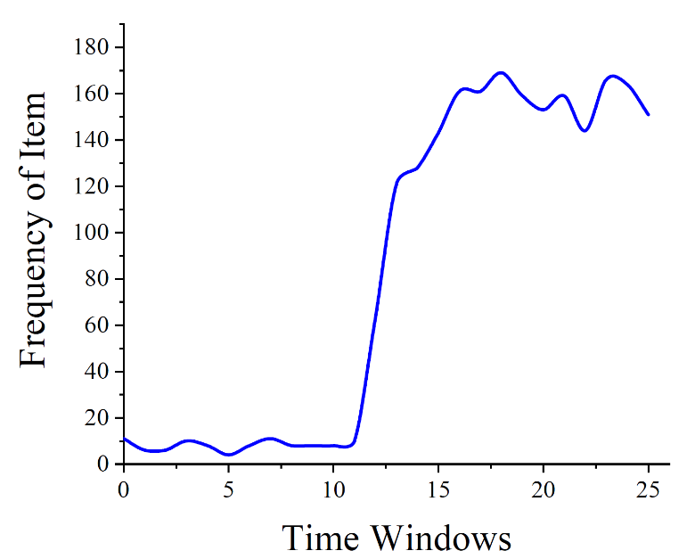
Background
Related Work
TopicSketch: Burst topic detection
CM-PBE: Resource-efficient burst detection in history
Pulse-like pattern
Large acceleration
Notes:
The related work is TopicSketch and CM-PBE. In fact, the difference between our algorithm and these two algorithms is very large. First, as mention before, the definition of burst is different. These two works regard large acceleration as burst, while we regard a pulse-like pattern as burst. The result is, we can not detect the bursts they defined, and they also can not detect the burst we defined. Second, the focus of the three algorithms is different. TopicSketch can only detect burst events on Twitter, while our detection is general. CM-PBE focuses on burst detection in history, while we focus on real-time burst detection. Third, these two algorithms just use the most classic sketch, Count-Min sketch, to detect burst, while we use more advanced sketches algorithm to raise our accuracy.

Slide 10
02
Part Two
Algorithm
Notes:
The second part is the algorithm.

Slide 11
Algorithm
Strawman solution:
$m$ Count-Min Sketch
……………
burst
1
2
3
4
5
6
time
Notes:
First we introduce the strawman solution. We use m Count-Min sketch to record the latest m time window’s frequency. The first Count-min sketch record the first time window, and the second Count-min sketch record the second time window, and so on……Now we know the latest m time window’s frequency. So we just check each item if they burst in the latest m time window. If we find a pattern like this, we report a burst occurs. This approach can detect burst smaller than m-2 window. However, in this way, the space complexity and time complexity for each item are both O(m). In contrast, these two complexities of BurstSketch are O(1).

Slide 12
Algorithm
$$e_{1}$$
$$e_{1}$$
$$e_{3}$$
$$e_{4}$$
$$e_{2}$$
Stage 1: Using Running Track to select potential bursts
Stage 2: Using Snapshotting to monitor potential bursts
$$e_{2}$$
Burst
Notes:
BurstSketch has two stages: stage 1 and stage 2. Stage 1 is like a filter, it selects potential burst and inserts them into stage 2. Stage 2 storage potential bursts and double-check if there is really a burst occurring. Each item inserted to BurstSketch will first be inserted to stage 1, then be inserted to stage 2.

Slide 13
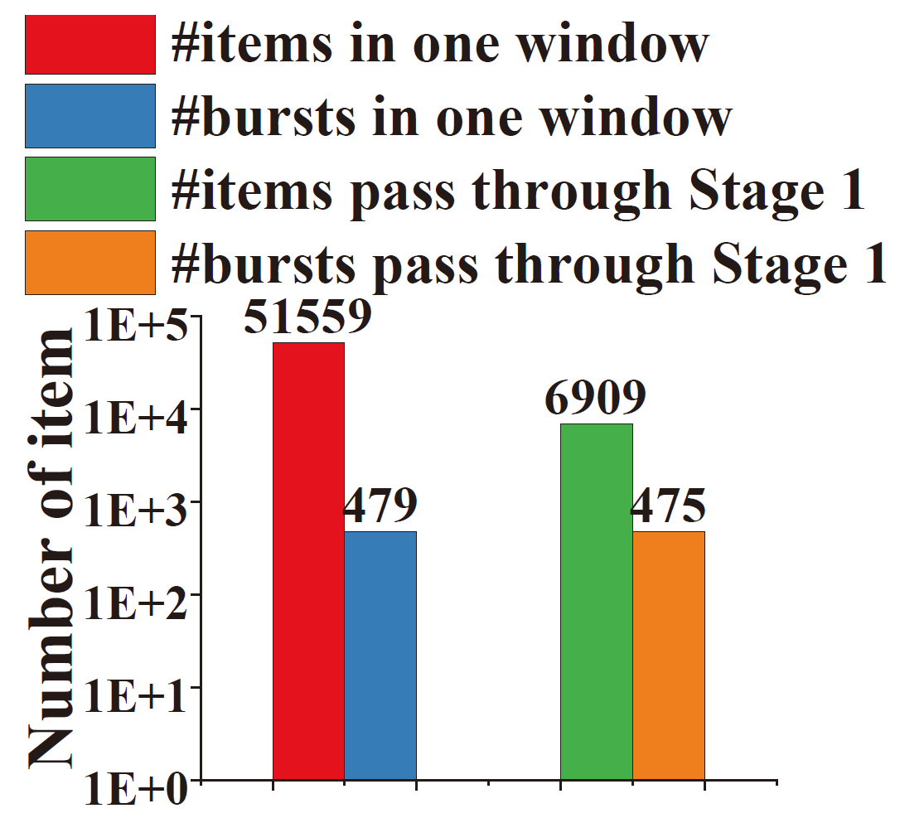
Algorithm
$$e_{1}$$
$$e_{1}$$
$$e_{3}$$
$$e_{4}$$
$$e_{2}$$
Stage 1: Using Running Track to select potential bursts
$$e_{2}$$
Just 13% items pass stage 1
Almost no burst item filter out by stage 1
Potential burst
Notes:
Stage 1 uses the technique of running track to select potential burst items and send them to stage 2. The technique of running track means that we randomly send items to different running track, and let the items in the same track compete. And the fastest item, that is, the champion of each track, has a chance to be regarded as a potential burst. We can see that lots of items are inserted into the stage 1, and just a few items will be regarded as potential burst. And the non-potential burst, that is, items with a small arrival rate, will be filtered out in stage 1. Let see our experimental result: the red column donate the number of items, and the green column donates the number of items regarded as potential burst. We can see that only 13% items are regarded as potential bursts. It can highly decrease the workload of stage 2 to save memory. The blue column donates the number of real bursts. And the orange column donates the number of bursts regarded as potential bursts. From 479 to 475, we can see that almost no real burst item was wrongly filtered out by stage 1.

Slide 14
Algorithm
Potential burst
$$e_{1}$$
$$e_{1}$$
$$e_{3}$$
$$e_{4}$$
$$e_{2}$$
Stage 2: Using Snapshotting to monitor potential bursts
$$e_{2}$$
$x$ window burst
Notes:
Then we will insert all the potential burst items to stage 2. Stage 2 use snapshotting to monitor if there is a burst occurring. The snapshotting means that we would not record the entire pattern of an item. Instead, we just take a snapshotting when the item’s speed sudden increase or sudden decrease, because the sudden increase and the sudden decrease can directly characterize the burst. Therefore, the complexity of the insertion speed and space is O(1).

Slide 15
Current time: 8
Burst threshold: 100
Stage 1 threshold: 50
$$e_{2}$$
$$e_{5}$$
$$e_{3}$$
$$e_{4}$$
$$e_{1}$$
Stage 1: Using Running Track to select potential bursts
Stage 1：
$$\text{……}$$ | $$\text{……}$$ | $$e_{2},10$$ | $$\text{……}$$ | $$e_{7},1$$ | $$\text{……}$$ | $$e_{6},45$$ | $$\text{……}$$ | $$\text{……}$$ | $$e_{4},49$$ | $$\text{……}$$ | $$\text{……}$$ | $$empty$$
$$e_{2},11$$
$$empty$$
$$e_{6},44$$
$$e_{4} ×50$$
$$empty$$
$$e_{1},1$$
Stage 2: Using Snapshotting to monitor potential bursts
$$\text{…………}$$
$$\text{…………}$$
$$(e_{8},210, 330, 2)$$
$$\text{…………}$$
$$\text{…………}$$
$$empty$$
$$\text{…………}$$
$$\text{…………}$$
$$\text{…………}$$
$$\text{…………}$$
$$\text{…………}$$
$$(e_{9},5,15,6)$$
$$(e_{9},5, 15, 0)$$
$$(e_{10},125, 90, 4)$$
$$(e_{11},150, 350, 0)$$
$$(e_{12},400, 120, 3)$$
Stage 2：
Notes:
Now I will show you an example and explain how BurstSketch works. Stage 1 is a hash bucket array. Each bucket record an item’s ID and frequency. For an incoming item, we hash it into d hash buckets. In this example, d equals one. If the bucket is empty, we insert the item in it and set its frequency as 1. If the incoming item’s ID and the bucket’s ID are the same, we increase the frequency by 1. If the item’s ID is different from the bucket’s ID, the incoming ID will try to evict the bucket’s ID. So the bucket’s frequency will be decreased by one. And when a bucket’s frequency is decreased to 0, like e7, the ID will be evicted, and the bucket will be cleaned to empty. When an item’s frequency reaches a threshold, which is 50 in this example, the item will be regarded as a potential burst, and it will be sent to stage 2. After that, the bucket in stage 1 will be cleaned to empty, because e4 is already a potential burst, and no more need to pass stage 1. In this way, slow items will be filtered out, and fast items will be inserted into stage 2.

Slide 16
Current time: 8
$$d:1$$
$$k:2$$
Burst threshold: 100
Stage 1 threshold: 50
$$e_{8}$$
$$e_{2}$$
$$e_{5}$$
$$e_{3}$$
$$e_{4}$$
$$e_{1}$$
Stage 1：
$$\text{……}$$ | $$\text{……}$$ | $$e_{2},10$$ | $$\text{……}$$ | $$e_{7},1$$ | $$\text{……}$$ | $$e_{6},45$$ | $$\text{……}$$ | $$\text{……}$$ | $$e_{4},49$$ | $$\text{……}$$ | $$\text{……}$$ | $$empty$$
$$e_{2},11$$
$$empty$$
$$e_{6},44$$
$$e_{4} ×50$$
$$empty$$
$$e_{1},1$$
$$\text{…………}$$
$$\text{…………}$$
$$(e_{8},210, 330, 2)$$
$$\text{…………}$$
$$\text{…………}$$
$$empty$$
$$\text{…………}$$
$$\text{…………}$$
Eviction
$$empty$$
$$\text{…………}$$
$$\text{…………}$$
$$\text{…………}$$
$$(e_{9},5,15,6)$$
$$(e_{9},5, 15, 0)$$
$$(e_{10},125, 90, 4)$$
$$(e_{11},150, 350, 0)$$
$$(e_{12},400, 120, 3)$$
Illegal Burst
$$(e_{10},125, 90, 0)$$
Stage 2：
Sudden Increase
$$(e_{11},150, 350, 8)$$
16
Sudden Decrease
$$(e_{12},400, 120, 0)$$
$$(e_{8},210, 331, 2)$$
$$(e_{4},0, 50,0)$$
Report $e_{12}$ as a 5 window burst
$$record each items’ information：(ID,previous window^{′}s frequency, current window^{′}s frequency,$$
$$the newest sudden increase window^{′}s number)$$
Notes:
Stage 2 is to monitor potential burst. It is also a bucket array. Differently, each bucket in Stage 2 can storage more than 1 item. In this example, can storage 4 items. To accurately detect burst, for each potential burst item, we record 4 of its information. They are the item’s ID, its frequency in the previous window, its frequency in the current window, and the newest sudden increase window’s number. Similarly, for each item inserted into stage 2, we will hash it into a hash bucket. If the bucket is not full, we insert the item into the bucket. Notice that 50 e4 items was inserted into stage 2, so we insert e4 into the bucket, and initialize its frequency in the current window to 50. If an incoming item’s ID has already been in stage 2, we will directly insert it into stage 2 because it has already been a potential burst. The result is that its frequency in the current window increase by 1. At the end of each time window, we will scan the whole stage 2 to check if bursts occur. Suppose the burst threshold is 100, which means the windows between the burst’s sudden increase and sudden decrease window must higher than 100. The frequency of e9 in the recent two time windows is both lower than the burst threshold. Therefore, we think e9 is no more a potential burst and evict it from Stage 2. For e10, its frequency in the current window is lower than the burst threshold, so we clean its newest sudden increase time window’s number to 0 to make sure this illegal burst would not be reported. Suppose the parameter k is 2, where k is related to the definition of sudden increase and sudden decrease. For e11, we find that its frequency in the current window is 2 times larger than the previous window, so we know a sudden increase happened. To record the sudden increase, we record the current window’s number to its newest sudden increase window’s number. In this example, the number is 8. Similarly, for e12, we find that its frequency in the current window is 1 over 2 times smaller than the previous window, so we know a sudden decrease happened. And the bucket record that e12 newest sudden increase is in the third time window, so we report a 5 time window burst of e12 occurs and clean the newest sudden increase window’s number to zero.

Slide 17
Algorithm
$$e_{1}$$
Basic version:
Stage 1：
$$\text{……}$$ | $$empty$$ | $$\text{……}$$ | $$e_{2},10$$ | $$\text{……}$$ | $$\text{……}$$ | $$\text{……}$$ | $$empty$$
$$e_{1},1$$
$$e_{2},9$$
$$e_{1},1$$
Duplication
$$e_{1}$$
Optimized version:
Stage 1：
$$\text{……}$$ | $$empty$$ | $$\text{……}$$ | $$e_{2},10$$ | $$\text{……}$$ | $$\text{……}$$ | $$\text{……}$$ | $$empty$$
unchanged
unchanged
$$e_{1},1$$
Notes:
We also have an optimization version to reduce duplication. It can raise the accuracy of BurstSketch. The specific approach is in the paper.

Slide 18
03
Part Three
Experimental Results
Notes:
The final part is about the experimental results.

Slide 19
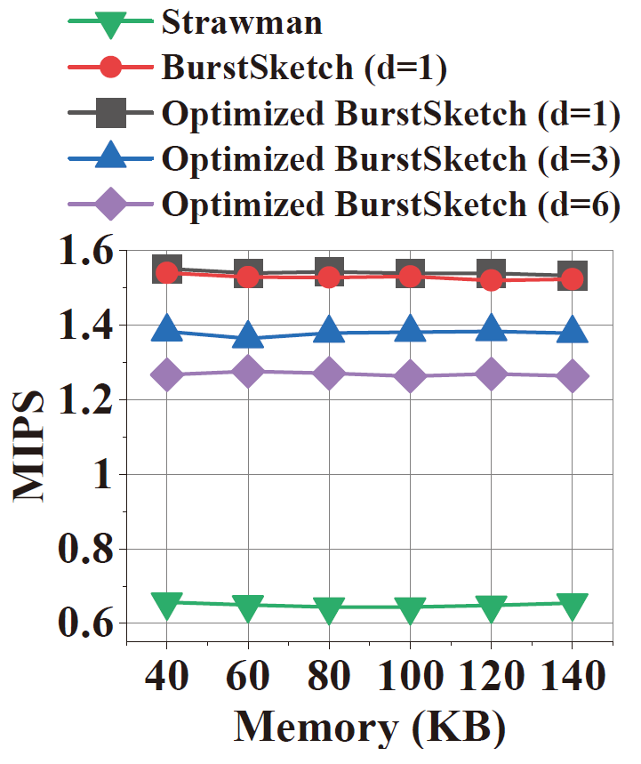
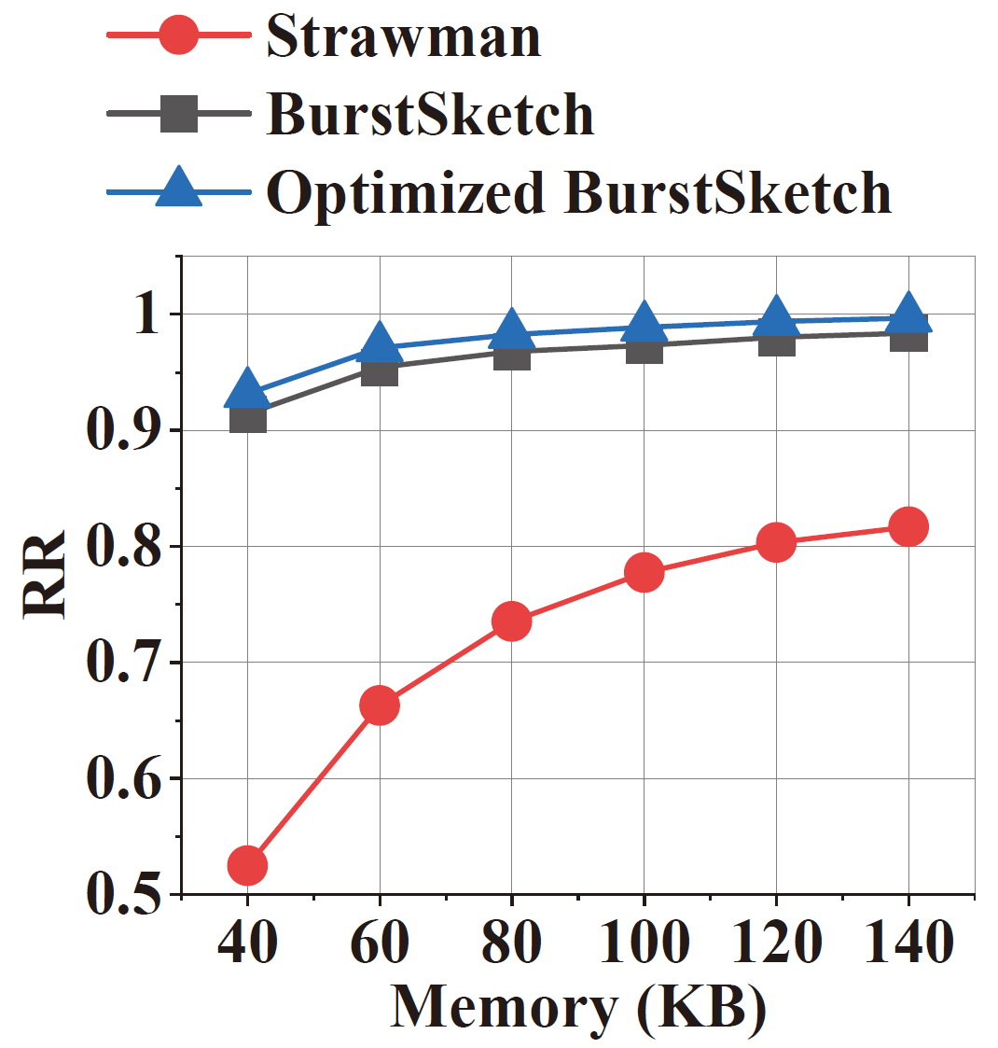
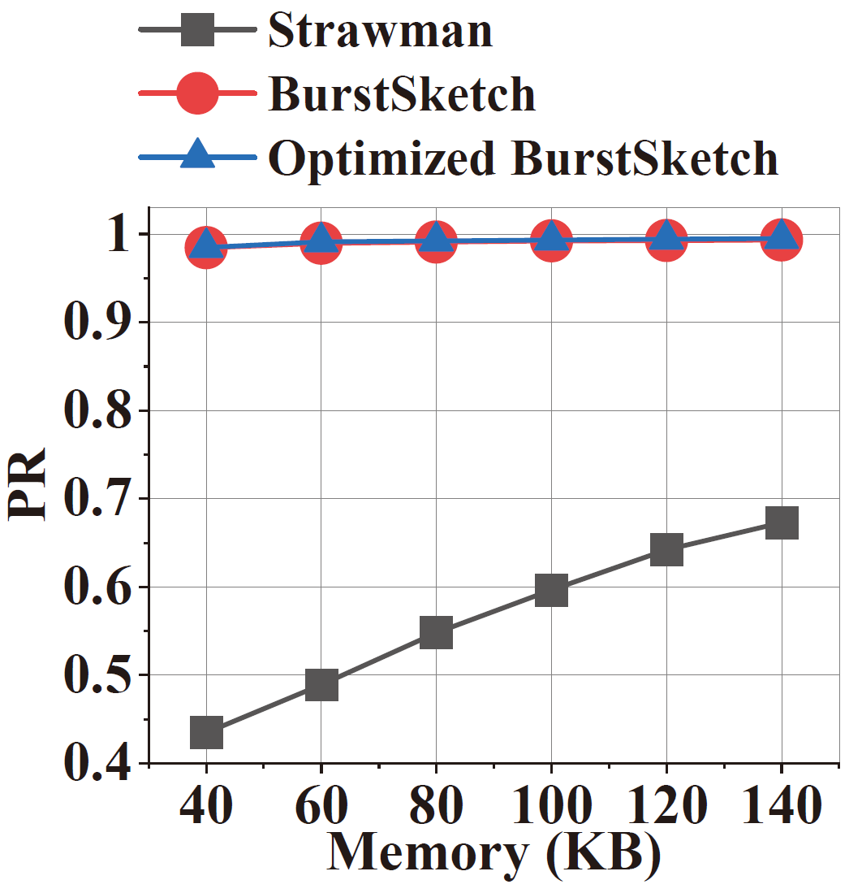
Experimental Results
Recall rate
$$\frac{\text{\#}\text{correctly} \text{reported}}{\text{\# }\text{true} \text{instances} }$$
Precision rate
$$\frac{\text{\#}\text{correctly} \text{reported}}{\text{\#}\text{reported} \text{instances}}$$
Throughput
Million insertions per second
Notes:
Our metric is Recall rate, precision rate, and throughput. Recall rate is the ratio of the number of correctly reported to the number of true instances. Precision Rate is the ratio of the number of correctly reported to the number of reported instances. Throughput is million insertions per second. We can see that our recall rate and precision rate is much better than the strawman solution. When the memory usage is 100KB, the recall rerate of our basic version is over 97%, and the optimization version is over 98%. The precision rate of BurstSketch is over 98% in all memory usage. The conclusion is, using a small amount of memory, BurstSketch’s accuracy is very high. Let’s see the throughput result. BurstSketch’s throughput outperforms the strawman solution. We find that parameter d in the optimization version is a trade-off between accuracy and throughput. The throughput drop with the increasing d, while the accuracy grows with the increasing d. The throughput of BurstSketch with d equal to one can achieve 1.6 million insertions per second.

Slide 20
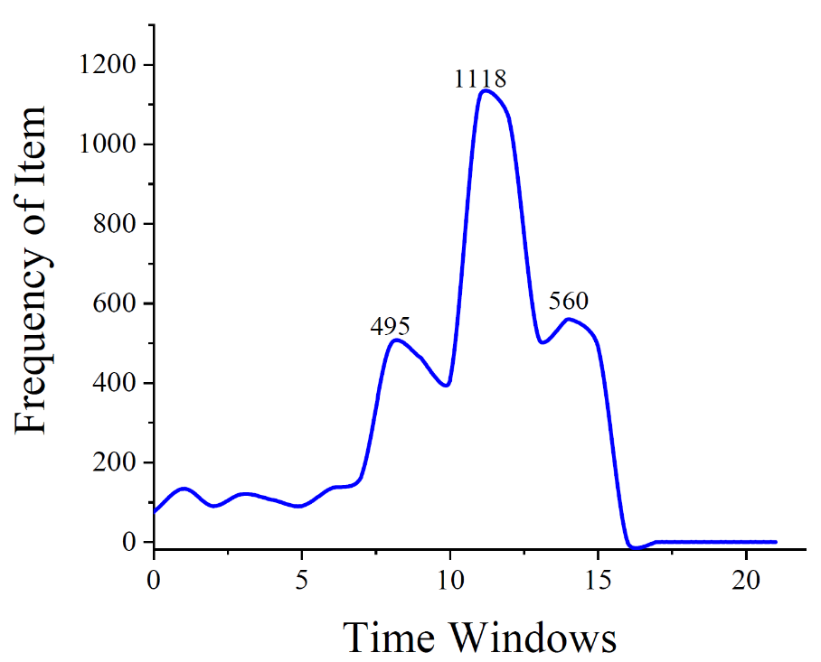
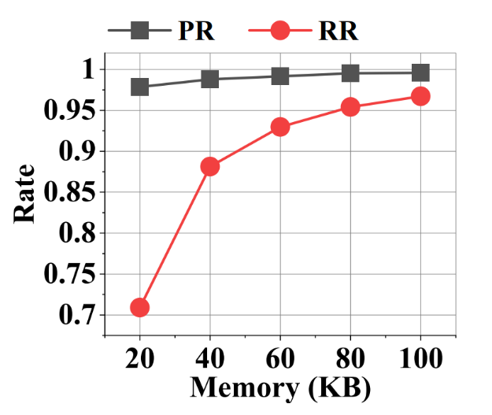
Experimental Results
burst
burst inside burst
Notes:
We also have an extended version to detect burst inside burst. In our basic version, only the middle burst with the largest peak value would be regarded as burst. It can make sure there is just at least one burst in a very moment. In the extended version, we also regard the bottom one as burst since it also has a sudden increase and a sudden decrease. So there are two bursts. We call the middle one burst inside burst. The specific algorithm of the extended version is in the paper. And the experimental result is, its recall rate and precision rate just drop a little compared to the basic version.

Slide 21
Thank you
Our code is open-source!
https://github.com/BurstSketch/BurstSketch
Notes:
That is my talk. Our cold is open-sourced in Github. Thank you!

